Slide 1

IT TICKET ANALYSIS VIVEK KUMAR YADAV 15/05/2025
FP20
ANALYTICS

Slide 2
Project analysis slide 2
Introduction & Objective
Did you know that IT support teams can spend up to 30% of their time just sorting through tickets? That’s a staggering amount of time that could be better spent on innovation and improving user experience!
Did you know that companies lose up to 20% of their revenue due to inefficient IT support? It's a alarming figure that highlights just how crucial effective ticket management can be for businesses today.
Objectives
Analyze IT support ticket management system for performance insights;
Assess speed and effectiveness of ticket resolutions by IT agents;
Evaluate employee satisfaction with IT support;
Identify high-performing agents and those needing additional assistance;
Aim to make informed staffing decisions to enhance service quality and team performance;

Slide 3
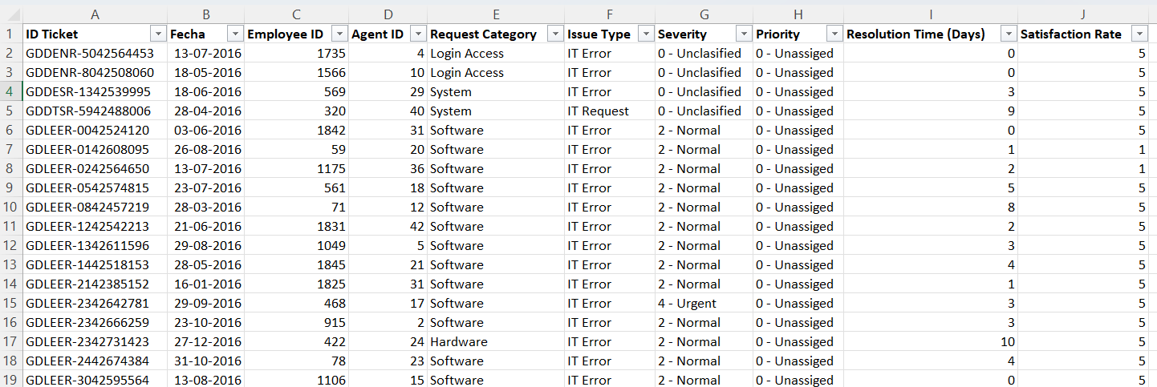
Project analysis slide 2
IT Ticket Analysis
PROBLEM STATEMENT
You are tasked with analyzing the IT support ticket management system to understand the performance of IT agents, the efficiency of ticket resolution, and the satisfaction levels of employees. The objective is to identify high and low performers among IT agents, assess the overall effectiveness of the team, and pinpoint areas for improvement in the ticket resolution process. The ultimate goal is to make informed staffing decisions, including hiring, firing, and training, to enhance overall service quality and team performance.

Slide 4
Project analysis slide 2
Dataset Overview
TICKETS
IT AGENTS
ID: Unique identifier for each support ticket.
Creation Date: Date the ticket was created.
Employee ID: ID of the employee who raised the ticket.
Agent ID: ID of the IT agent assigned.
Request Category: Type of request (e.g., Login Access, System, Software).
Issue Type: Nature of the issue (e.g., IT Error, IT Request).
Severity: Classification of issue severity.
Priority: Assigned priority level.
Resolution Time (Days): Time taken to resolve the ticket.
Satisfaction Rate: Employee rating (likely out of 5)
KEY VARIABLES
Agent ID: Unique identifier for IT agents.
Full Name: Name of the IT agent.
Email: Contact email
Year, Month, and Day of Birth: Birth details.
Agent Performance: Identify top and low-performing agents based on ticket volume, resolution time, and satisfaction scores.
Ticket Resolution Efficiency: Assess average resolution times and identify delays
Employee Satisfaction: Evaluate overall satisfaction trends.

Slide 5
Data Overview
The IT Support Team manages a high volume of tickets — nearly 97,500 annually
Tickets Analyzed: 97,498
IT Agents Involved: 51
Data Fields Include:
Ticket Metadata: Ticket ID, Date, Request Category, Issue Type
Agent Information: ID, Name, Age
Metrics: Resolution Time,
Satisfaction Rate, Priority, Severity
Ticket Breakdown Samples:
Issue Types:
IT Request – 73,220 tickets
IT Error – 24,278 tickets
Metrics of Interest:
Avg. Resolution Time: ~4.55 days
Avg. Satisfaction Rate: 4.1 / 5

Slide 6
Summary of Analysis Conducted
Categorical Grouping:
By issue type, request category, and agent ID
Performance Metrics Analyzed:
Average Resolution Time
Customer Satisfaction Rate
Severity & Priority Trends
Agent Load Distribution:
Tickets handled per agent to assess workload
Dashboards Created for:
Issue trends & Distribution of Tickets
Request category insights
Agent performance metrics

Slide 7
Summary of Analysis Conducted
Ticket Volume Over Time(2016-20):
Insights:
Ticket volume rose steadily, peaking in 2020.
Seasonal peaks in Mar, Aug, Oct, Dec.
2020 spike likely due to remote work.
Recommendations:
Boost support in peak months.
Analyze 2020 surge causes.
Promote self-service tools.

Slide 8
Summary of Analysis Conducted
Ticket on Request Category:
Insights:
Software requests have the highest satisfaction rate despite longer resolution times.
Login Access has the fastest resolution but lowest satisfaction.
Hardware and System have similar times and moderate satisfaction.
Recommendations:
Investigate low satisfaction for fast-resolving Login issues.
Maintain high support quality for Software despite longer times.
Improve System and Hardware response to boost satisfaction.

Slide 9
Summary of Analysis Conducted
Agent Handling Ticket
Purpose : Performance of individual agents Agent Efficiency
Agents with a lower average resolution time are more efficient in closing tickets.
Performance Benchmarking You can identify top performers (e.g., those consistently under 4 days) and compare them with slower peers.
Training Opportunities If some agents have significantly higher average resolution times, they might benefit from process
IT Agents | Average of Resolution Time (Days)
Yomaira Agudelo | 3.82
Segura Garcia | 3.72
Alberto Gastelum | 3.71
Leon Lourdes | 3.71
Luis Arguello | 3.70
Guadalupe Torrico | 3.67
Galindo Guadalupe | 3.66
Isela Leyva | 3.65
Diana Rojo | 3.64
Jesus Grajeda | 3.60
IT Agents | Average of Satisfaction Rate
Eva Cardenas | 4.41
Alberto Casillas | 4.42
Marisol Piedrahita | 4.44
Barbara Grijalva | 4.44
Enrique Montiel | 4.44
Segura Garcia | 4.46
Galindo Guadalupe | 4.47
JesusGrajeda | 4.47
Javier D. | 4.49
Diana Rojo | 4.60
Top 10 Agents with Low Resolution Time and High Satisfaction Rate

Slide 10
Summary of Analysis Conducted
Insights:
Top agents resolve tickets in under 3.83 days.
Jesus Grajeda leads with the fastest resolution time (3.60 days).
Resolution times among top agents are closely clustered.
Recommendations:
Recognize and reward high performers.
Analyze top agents' workflows to replicate success across the team.
Use these benchmarks to set team-wide resolution targets.

Slide 11
Summary of Analysis Conducted
Insights:
Aurelio Tanori resolved the most tickets (2027), closely followed by Jesus Contreras (2026).
All top 10 agents resolved ~1980–2027 tickets, indicating a high-performing tier.
Recommendations:
Recognize top contributors for motivation and retention.
Study their methods to train and uplift lower-performing agents.
Monitor for burnout risk due to high workload.

Slide 12
Summary of Analysis Conducted
Insights:
Diana Rojo leads with the highest satisfaction score (4.60).
Several agents (e.g., Jesus Grajeda, Galindo Guadalupe) show consistent high performance across metrics.
Recommendations:
Leverage top agents for peer mentoring.
Analyse best practices contributing to high satisfaction.
Promote a service quality culture using these benchmarks.

Slide 13
Summary of Analysis Conducted
Issue Type
Purpose: Volume by type
IT Requests: ~73,220 tickets (~75%)
IT Errors: ~24,278 tickets (~25%)
Reveals the focus areas for automation or process improvement.
Insight:
75% of tickets are IT Requests, while 25% are IT Errors.
Recommendation:
Focus automation and self-service tools on IT Requests to reduce volume and improve efficiency.

Slide 14
Summary of Analysis Conducted
Ticket on Request Category
Purpose: Volume by request category
System: 39,002 tickets (40%)
Login Access: 29,193 tickets (30%)
Software: 19,570 tickets (20%)
Hardware: 9,733 tickets (10%)
The majority of tickets are System-related (40%), followed by Login access (30%), indicating key areas for automation and process improvement.
Insight:
Most tickets are for Login Access (40%) and System issues (30%).
Recommendation:
Prioritize Login Access automation and enhance monitoring for System stability.

Slide 15
Summary of Analysis Conducted
Tickets By Severity
Purpose: Impact-based ticket categorization Severity Levels (e.g., Critical, High, Medium, Low)
Ticket counts for each severity
Summary:
Helps prioritize resources based on business impact.
Insight:
Normal severity tickets dominate the volume, making up the vast majority (88,656).
Urgent, Minor, and Unclassified tickets are significantly lower in count.
Major severity issues are relatively few (4,836), indicating that most tickets are not business-critical.
Recommendations:
Automation Opportunity: Consider automating triage and resolution processes for Normal tickets to reduce workload and improve resolution time.
Urgent Ticket Monitoring: Ensure Urgent tickets (1,392) have dedicated workflows or escalation paths due to their critical nature.
Improve Classification: The presence of Unclassified tickets (356) suggests a need to enforce or improve ticket categorization standards

Slide 16
Summary of Analysis Conducted
Age wise Satisfaction Rate
Purpose: Satisfaction scores across age groups Data Includes:
Age Bands (Difference of 6 years)
Average Satisfaction Score
Summary: Shows satisfaction is mostly consistent across ages, indicating no strong age-related bias in support experience.
Insight:
Satisfaction drops significantly in the 43–49 age group.
Recommendation:
Investigate specific pain points for users aged 43–49 and tailor support or communication accordingly.

Slide 17
Summary of Analysis Conducted
Satisfaction Rate Distribution
High (5–6): 50,770 tickets (~52%)
Medium (3–4): 34,844 tickets (~36%)
Low (1–2): 11,884 tickets (~12%)
Insight: Over half of the users report high satisfaction, indicating generally positive IT support performance.
Insights:
Majority of tickets (51%) fall in the high satisfaction range (5–6).
35% of tickets scored moderately (3–4), indicating potential issues.
14% of tickets received low satisfaction (1–2), signaling critical areas of concern.
Recommendations:
Analyze low-score tickets to identify recurring issues or agents.
Train and support agents handling mid-range scores to boost service quality.
Recognize top-performing agents to reinforce best practices.

Slide 18
Summary of Analysis Conducted
Resolution Time Distribution
Fast (0–2 days): 40,814 tickets (~42%)
Moderate (3–5 days): 19,908 tickets (~20%)
Extended (6–8 days): 19,234 tickets (~20%)
Long (9–11 days): 7,638 tickets (~8%)
Very Long (>12 days): 9,904 tickets (~10%)
Insights:
Most tickets (41%) are resolved quickly (within 0–2 days).
28% take 3–8 days to resolve.
19% of tickets exceed 8 days, with 10% taking more than 12 days.
Recommendations:
Maintain and replicate processes used in 0–2 day resolutions.
Prioritize long-pending tickets (>8 days) for process improvement.
Investigate bottlenecks in mid-range resolutions (3–8 days) to enhance overall efficiency.

Slide 19
Summarized Conclusion
The analysis of 97,498 IT support tickets reveals a high-volume, high-impact operation with opportunities for optimization, automation, and targeted training.
Ticket Volume & Type: Most tickets are System (40%) and Login Access (30%), with IT Requests making up 75% of total issues—these are ripe for automation to reduce manual workload.
Resolution Time & Satisfaction: About 62% of tickets are resolved within 5 days, and 52% of users report high satisfaction (5–6 rating). However, 18% of tickets take over 9 days, correlating with lower satisfaction scores and pointing to bottlenecks.
Agent Performance: Agent handling analysis shows a wide range in average resolution time, suggesting top performers and others needing additional support or training.
User Demographics & Satisfaction: Satisfaction is generally consistent across age groups, with no major demographic gaps in service experience.
Issue Trends Over Time: Software-related issues have steadily increased year over year, signaling a growing demand for software support capacity.
Severity & Prioritization: Ticket severity distribution allows IT teams to prioritize critical issues effectively, though extended resolution times in high-severity cases should be minimized.

Slide 20
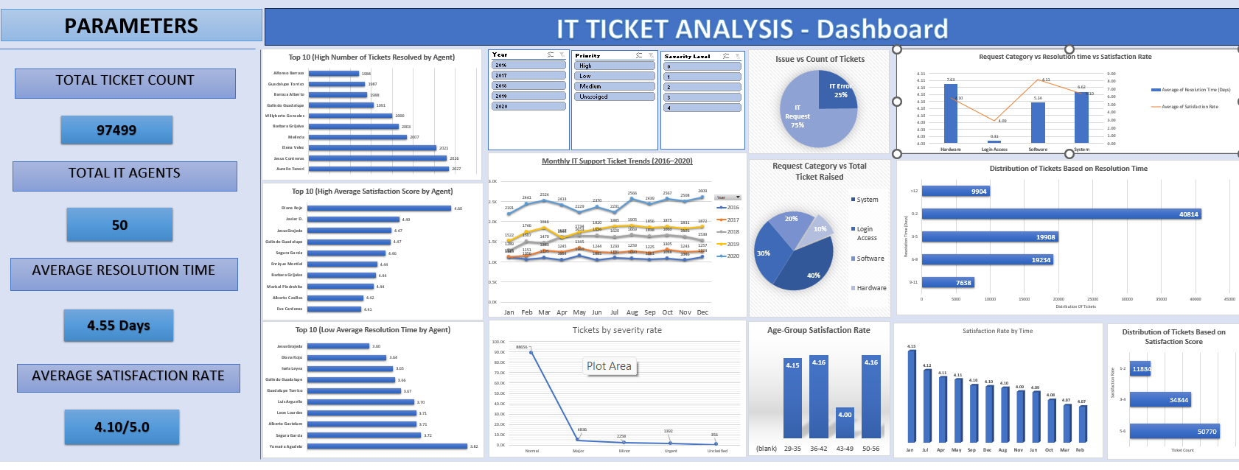
Dashboard

Slide 21
Thank You

